Slide 1
DATABASE MANAGEMENT WORKSHOP
DESIGNING & IMPLEMENTING RELATIONAL DATABASES
ARCHAEOLOGICAL INFORMATION INTEREST GROUP
MONDAY JANUARY 28, 2018
ZACK BATIST

Slide 2
SECTION 1
ABOUT THIS WORKSHOP

Slide 3
OUTCOMES
Understand what a database is, and how it relates to archaeological workflows
Understand how to design and maintain effective data structures
Understand how to input, modify and retrieve data
Create your own research database to suit your specific needs
Become a proficient user of the command line and develop practical computing skills

Slide 4
WORKSHOP STRUCTURE / LOGISTICS
Website: https://zackbatist.github.io/archaeo-db-workshop/
GitHub: https://github.com/zackbatist/archaeo-db-workshop/

Slide 5
ABOUT ME
Background doing network analysis and GIS
Looking at how archaeological practice is supported by and works alongside information infrastructures
I like lithics
I like R
I like using R to code cool things relating to lithics
I manage the databases at the Stelida Naxos Archaeological Project

Slide 6

ABOUT YOU

Slide 7
SECTION 2
WHAT IS A DATABASE?

Slide 8
WHAT IS A DATABASE?
"A database is an organized collection of data, generally stored and accessed electronically from a computer system."
~ Wikipedia:Database

Slide 9
THREE MAIN COMPONENTS:
Database Management System [DBMS]
Database Schema
Data

Slide 10
DATABASE MANAGEMENT SYSTEM [DBMS]
Software that mediates between end users, applications and the database itself

Slide 11
DATABASE MANAGEMENT SYSTEM [DBMS]
Data definition
Creation, modification and removal of definitions that structure the data
Update
Insertion, modification and deletion of actual data
Retrieval
Obtaining data from the database through a system of machine-readable commands
Administration
Registering and monitoring users, enforcing data security, monitoring performance, maintaining data integrity, etc

Slide 12
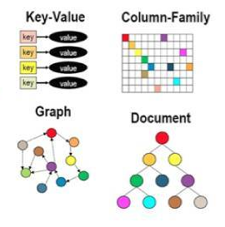
2. DATABASE SCHEMA
Overall architecture or structure of the database
The explicitly defined set of rules that structure the data and enable it to be input and retrieved in a systematic manner
Models include:
relational
graph/network
hierarchical/tree
key:value pairs/JSON

Slide 13
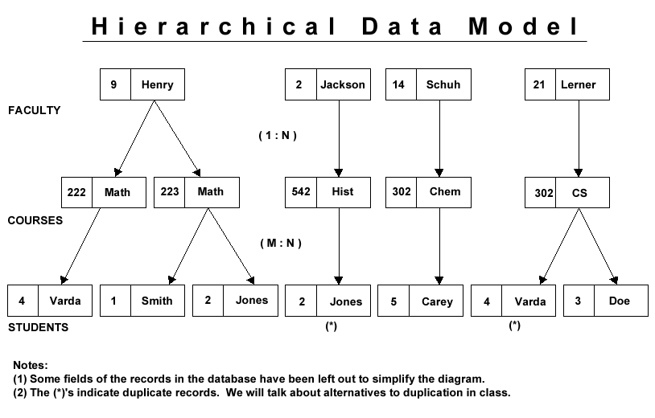
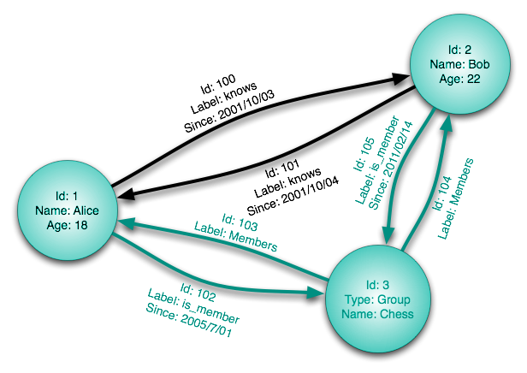
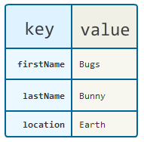

Slide 14
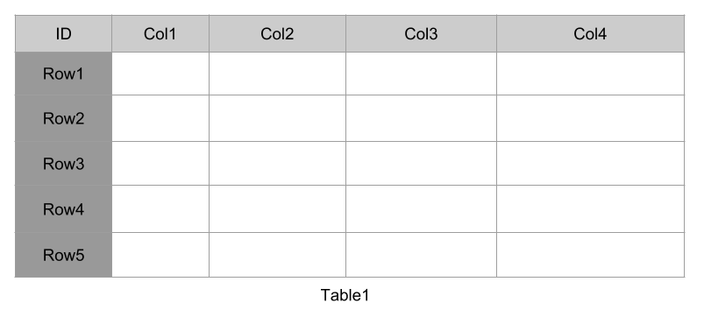
RELATIONAL DATABASES
Organizes data into a series of thematically-arranged tables of columns and rows

Slide 15
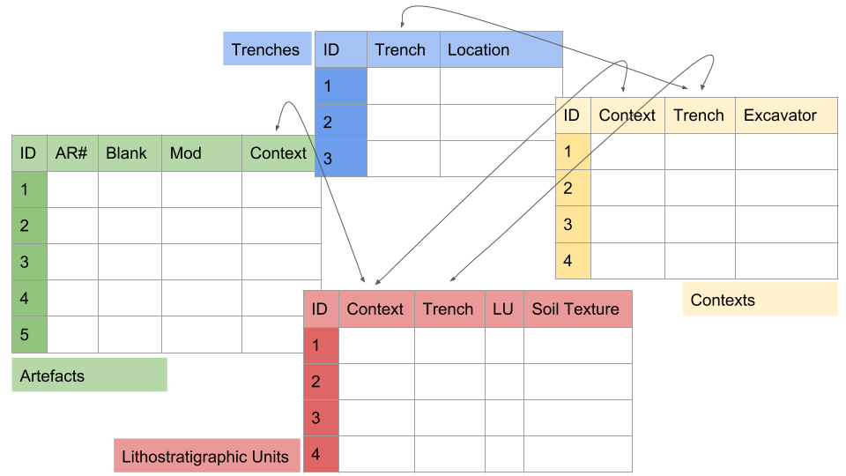
RELATIONAL DATABASES

Slide 16
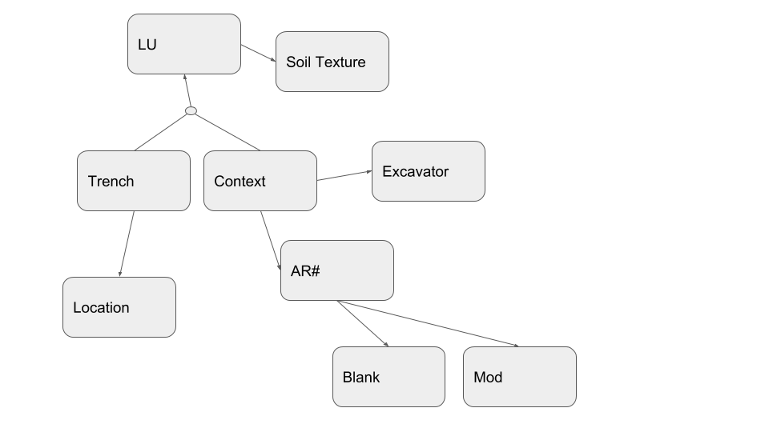
RELATIONAL DATABASES

Slide 17
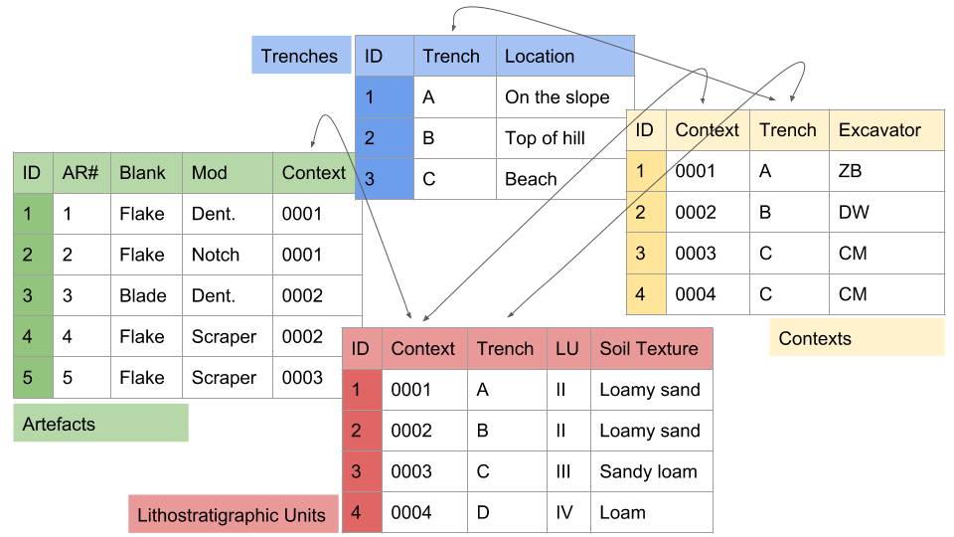
3. DATA
The contents of the database
Must 'fit' the schema

Slide 18
QUESTIONS?

Slide 19
SECTION 3
SETTING UP OUR DBMS

Slide 20
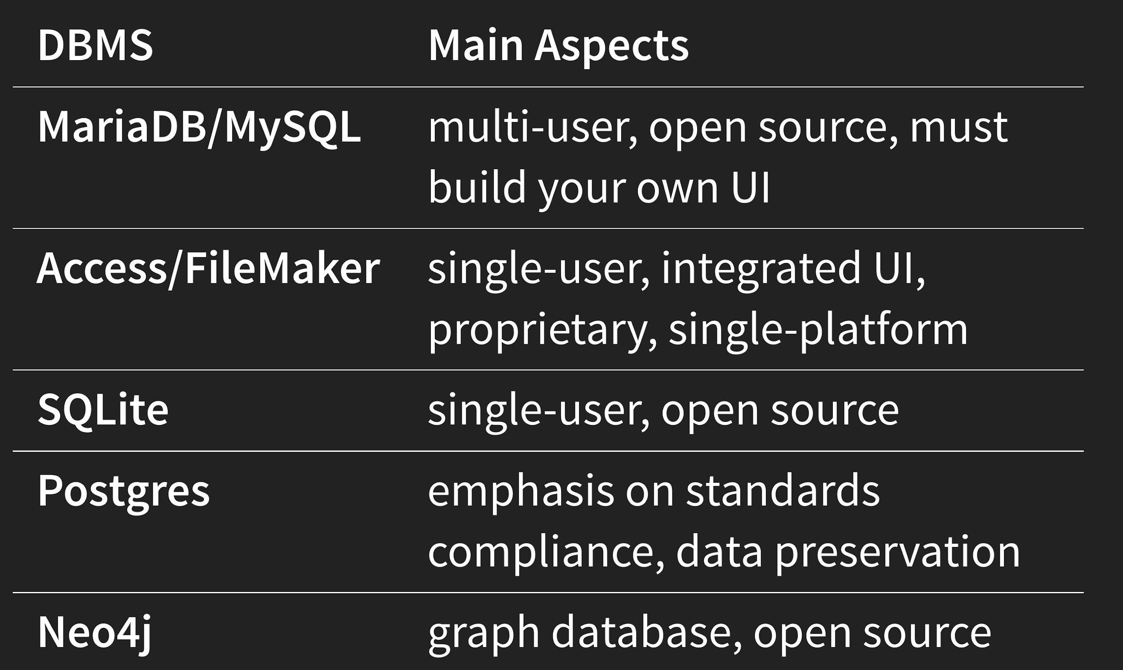
COMPARISON OF SOME DBMS

Slide 21
One person wrangles a bunch of emailed excel spreadsheets
Each user is granted access to a central server and can work independently

Slide 22
MARIADB SERVER SETUP
Database on a server, accessible by multiple clients
Data is centralized, unified and consistent
In this case…
hosted on a cloud platform [DigitalOcean]
free with an educational discount
physically situated in St. Lawrence Market

Slide 23
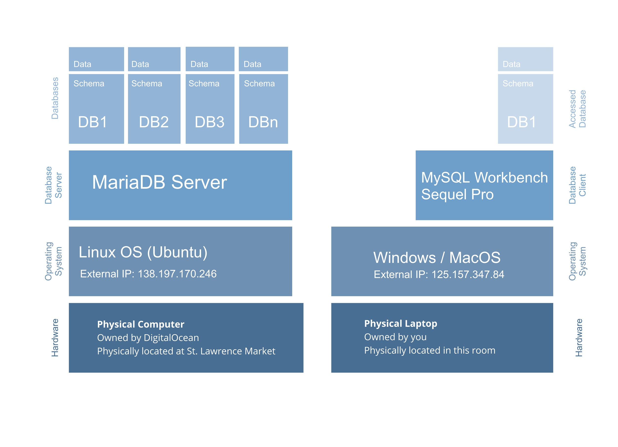
Server
Client

Slide 24
QUESTIONS?

Slide 25
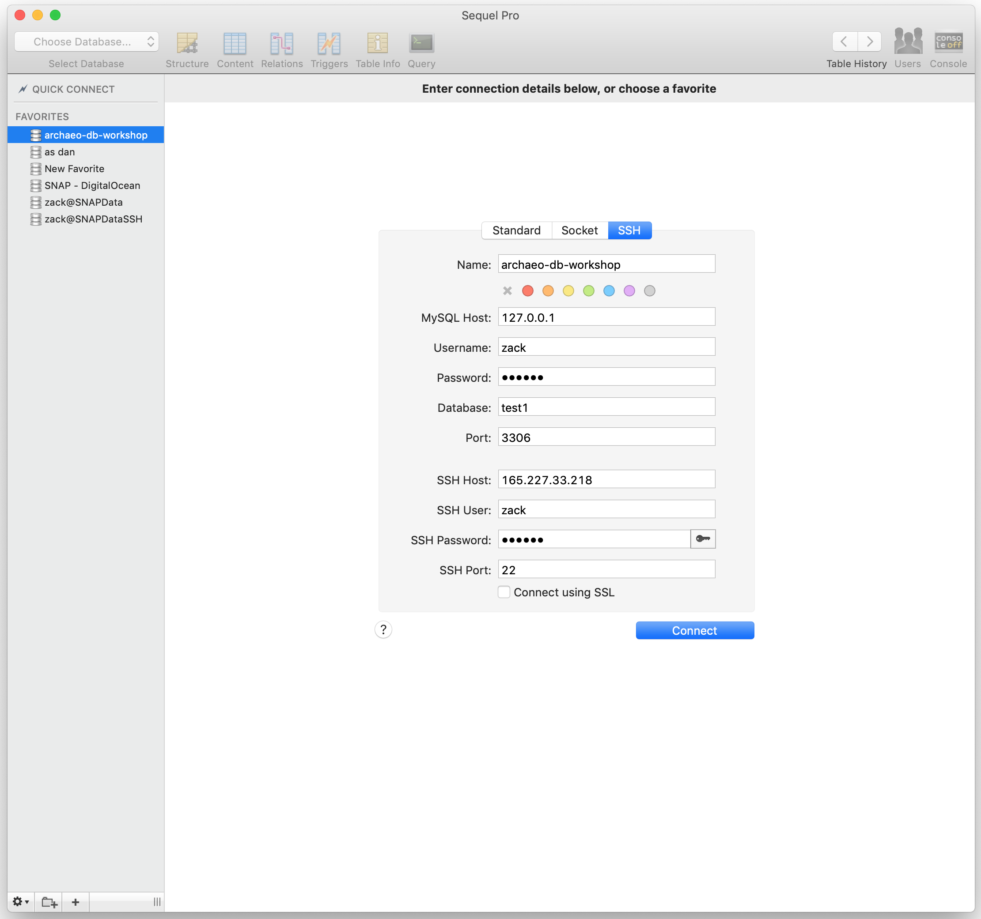
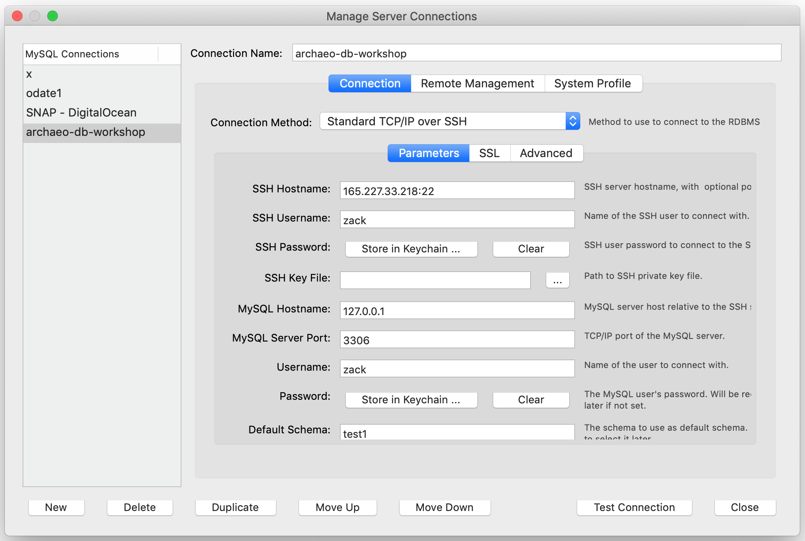
USING A GRAPHICAL CLIENT

Slide 26

USING A GRAPHICAL CLIENT

Slide 27
USING THE COMMAND LINE ~
DON’T PANIC!
~~~
Every action is intentional, direct and self-contained
~~~
It's like getting access to the breakfast buffet instead of ordering off the fixed menu!
~~~
University of Toronto Coders - Introduction to Bash
https://uoftcoders.github.io/studyGroup/lessons/misc/bash-intro/lesson/

Slide 28
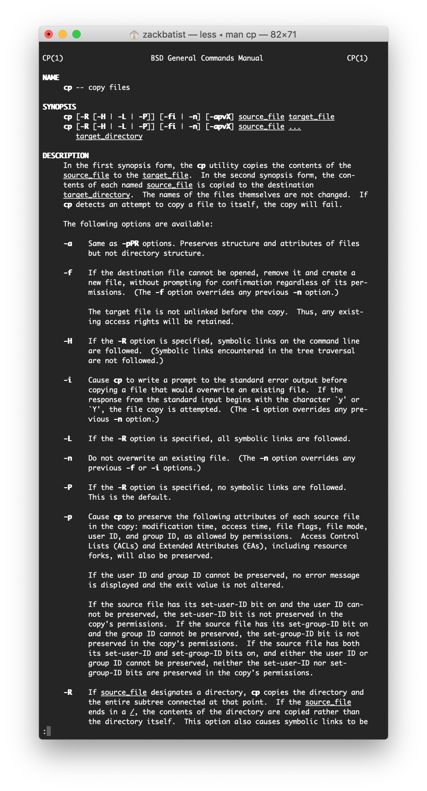
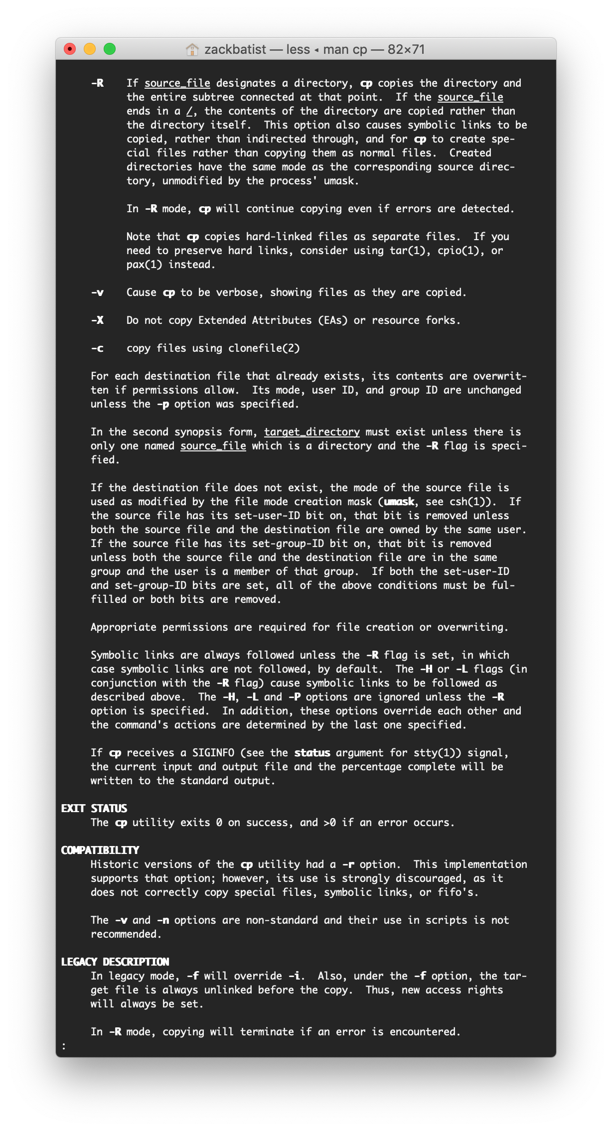
BASH
Command
Flags / options
Arguments
cp -R ~/files ~/files-backup

Slide 29
BASH
Command
Flags / options
Arguments
Command (copy)
cp -R ~/files ~/files-backup
Flag
(recursive)
Target directory
Source directory

Slide 30
BASH
Command
Flags
Directories and files
Common symbols and conventions
avoid spaces in file names
capitalization matters
'up' key cycles through your most recent command
.. is like going up one directory
~ is home directory
* is wild card
Command (copy)
cp -R ~/files ~/files-backup
Flag
(recursive)
Target directory
Source directory

Slide 31
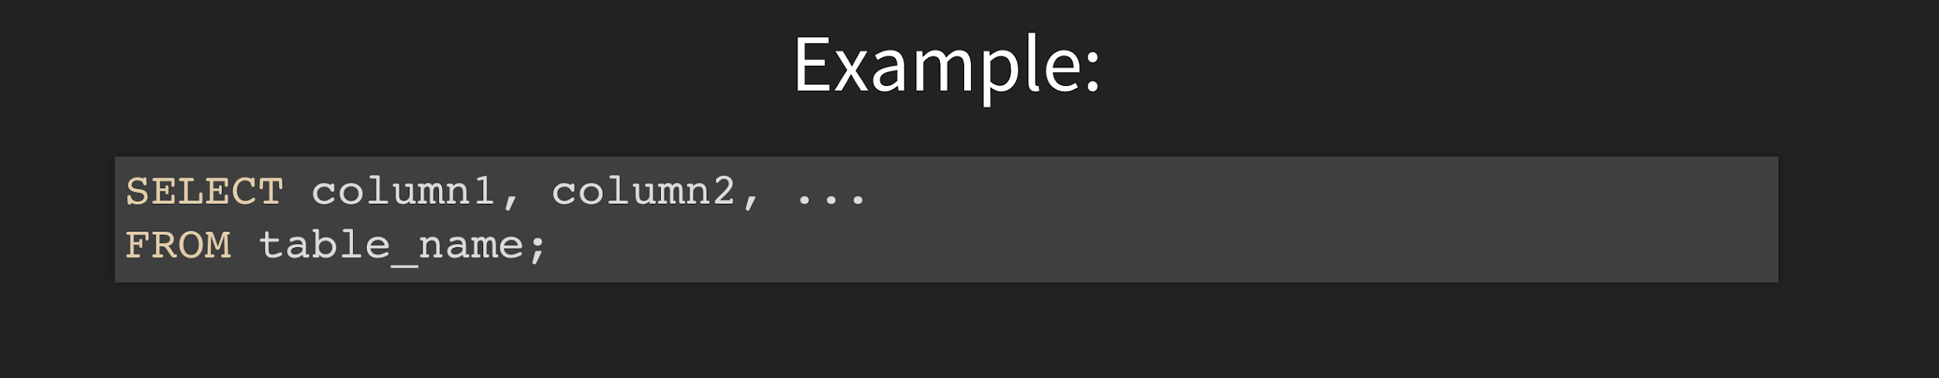
SQL [STRUCTURED QUERY LANGUAGE]
Language used to retrieve, modify, enter or manipulate data stored in a relational database
Self-contained logical statements that include all parameters needed to do a particular action
Semicolons [;] indicate the end of a command
If something doesn’t add up, the terminal will spit out an error and nothing will happen
https://www.w3schools.com/sql/default.asp

Slide 32
FANTASTIC RESOURCES:
University of Toronto Coders - Introduction to Bash
https://uoftcoders.github.io/studyGroup/lessons/misc/bash-intro/lesson/
Learn Enough Command Line to Be Dangerous by Michael Hartl
https://www.learnenough.com/command-line-tutorial/basics

Slide 33
Let’s go!
Connecting to the remote computer
ssh workshop@165.227.33.218
Input password: workshop1
Accept security certificate, type ‘yes’
You’re in! 🎉

Slide 34
Let’s go!
Connecting to the remote computer
Instructs the computer to use the information in the rest of the line to establish a link over the internet to the computer that hosts the database
The username on that computer
ssh workshop@165.227.33.218
Input password: workshop1
Accept security certificate, type ‘yes’
You’re in! 🎉
The location of that computer on the internet
Credentials to gain access
Used to ensure that your key fits the lock (or something…)

Slide 35
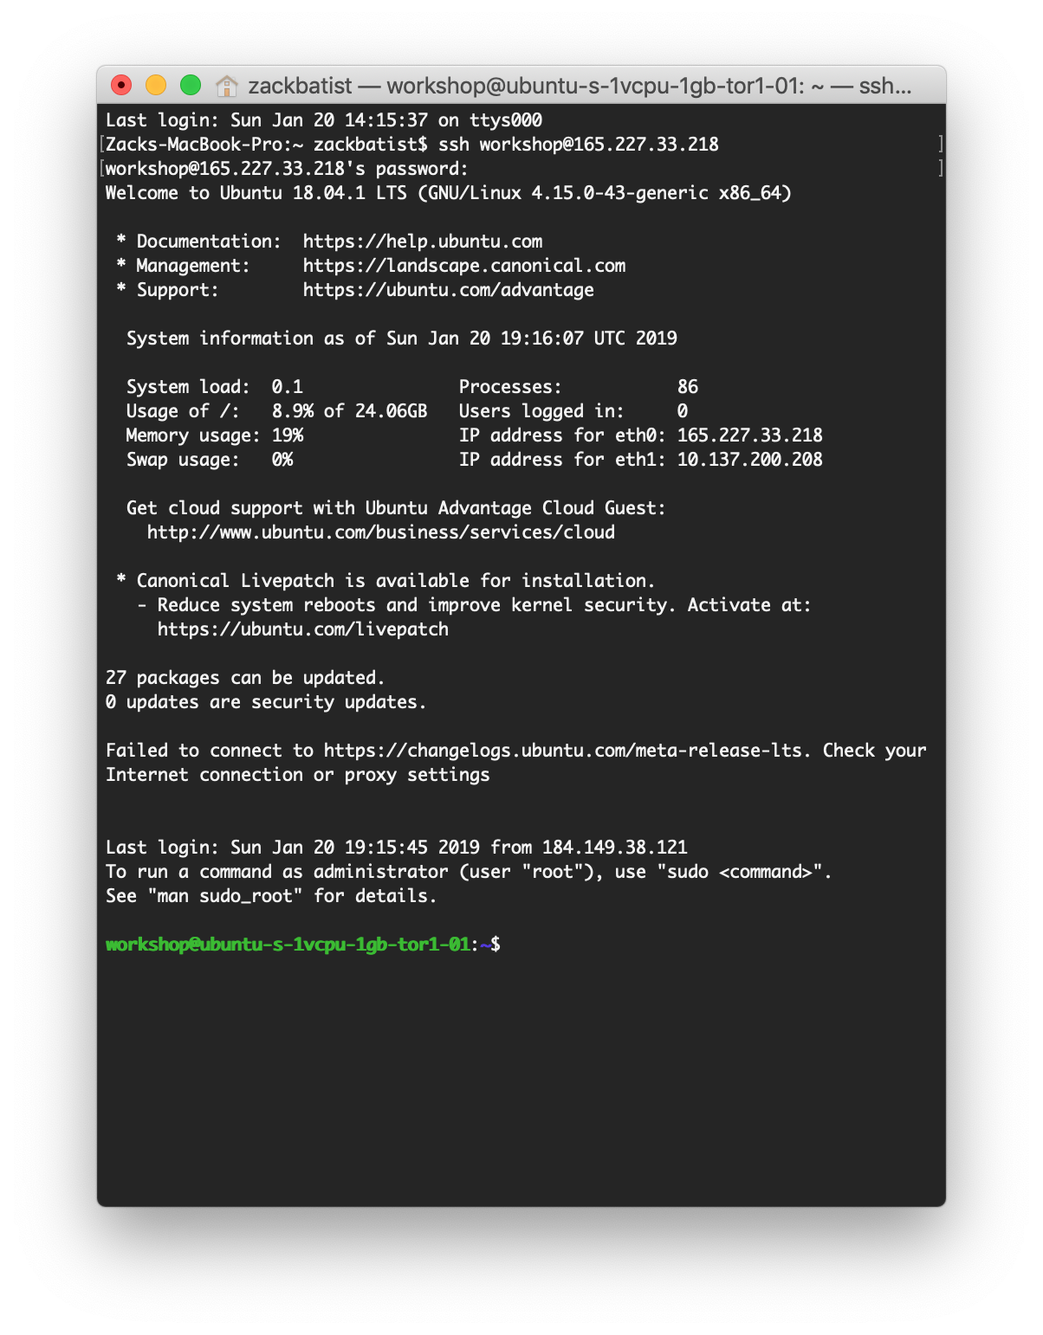

Slide 36
Let’s go!
Connecting to the remote computer
Connecting to the MariaDB server on that computer
Instructs the computer to use the information in the rest of the line to establish a link over the internet to the computer that hosts the database
The username on that computer
ssh workshop@165.227.33.218
Input password: workshop1
Accept security certificate, type ‘yes’
You’re in! 🎉
The location of that computer on the internet
Credentials to gain access
Used to ensure that your key fits the lock (or something…)
Mysql -u <username> -p
Enter your password
🥳

Slide 37
Let’s go!
Connecting to the remote computer
Connecting to the MariaDB server on that computer
Instructs the computer to use the information in the rest of the line to establish a link over the internet to the computer that hosts the database
The username on that computer
ssh workshop@165.227.33.218
Input password: workshop1
Accept security certificate, type ‘yes’
You’re in! 🎉
The location of that computer on the internet
Credentials to gain access
Used to ensure that your key fits the lock (or something…)
Mysql -u <username> -p
Enter your password
🥳
Instructs the computer to use the following information to grant access afforded to a user by the database administrator
Indicates that what follows is a username
Ensures that the computer prompts you to input a password

Slide 38
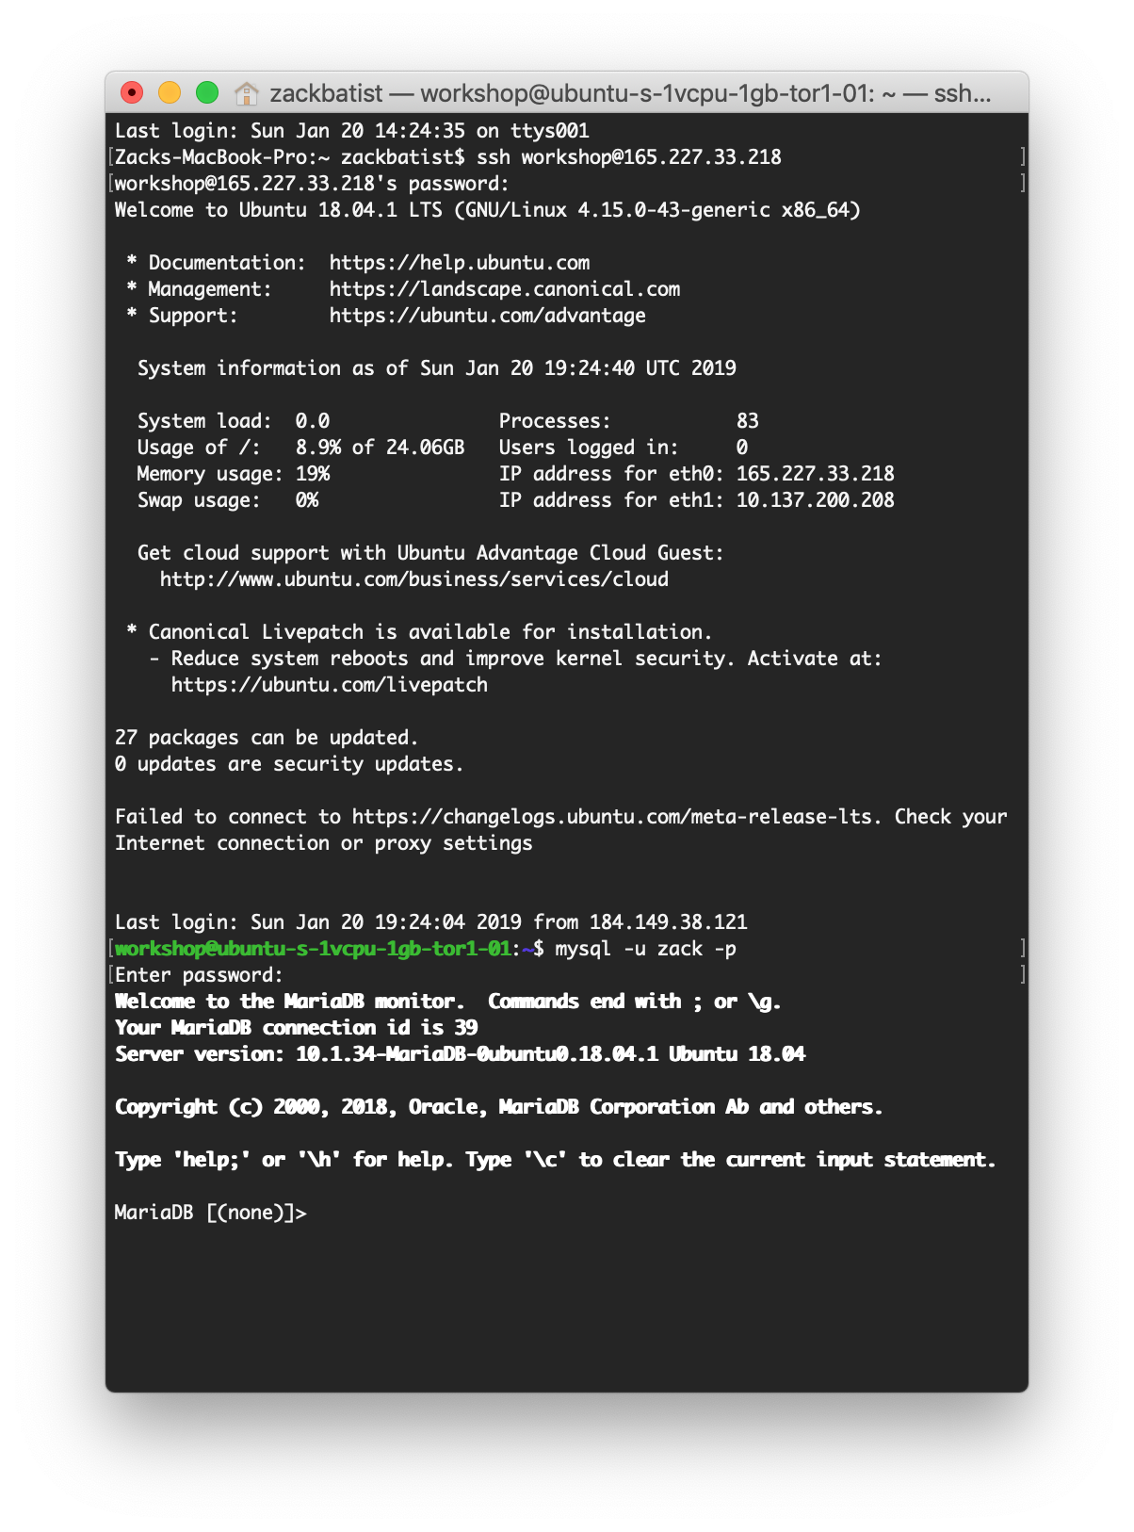

Slide 39
SQL [STRUCTURED QUERY LANGUAGE]
Language used to retrieve, modify, enter or manipulate data stored in a relational database
Self-contained logical statements that include all parameters needed to do a particular action
Semicolons [;] indicate the end of a command
If something doesn’t add up, the terminal will spit out an error and nothing will happen
https://www.w3schools.com/sql/default.asp

Slide 40
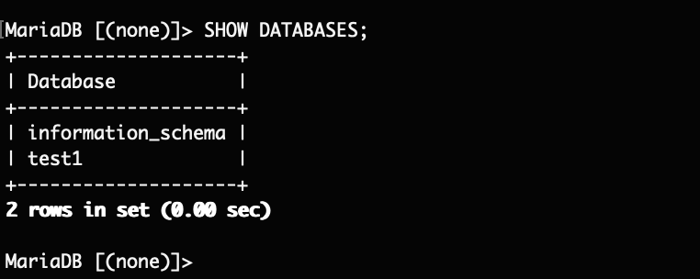
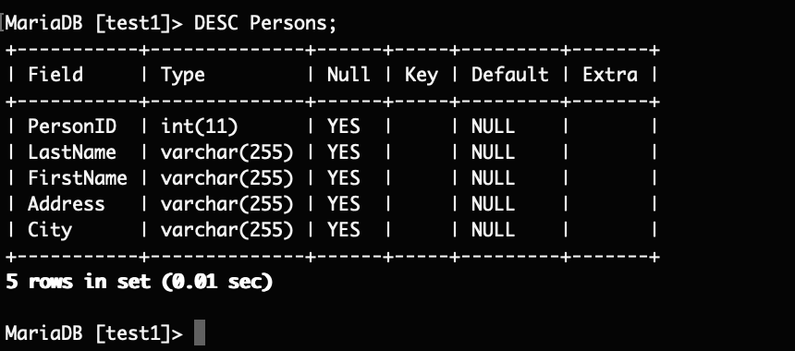
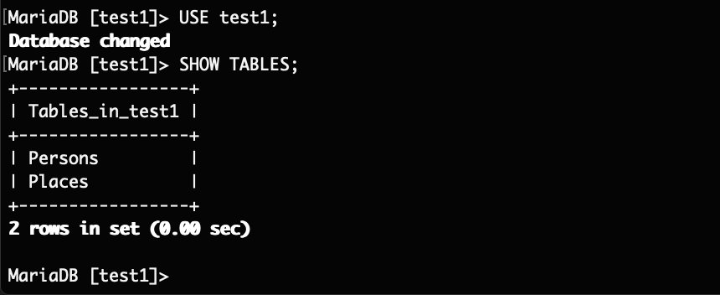
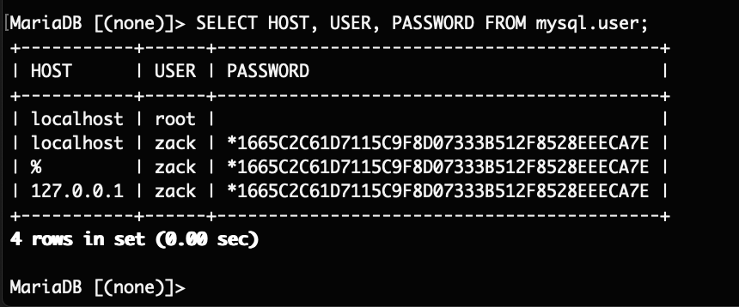
Show databases
Describe a table
Show tables
Inspect users (only as administrator)

Slide 41

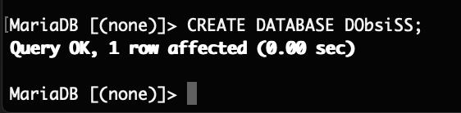
CREATING A DB ON THE SERVER
Syntax
Example

Slide 42
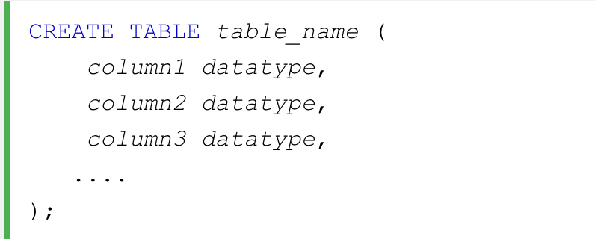
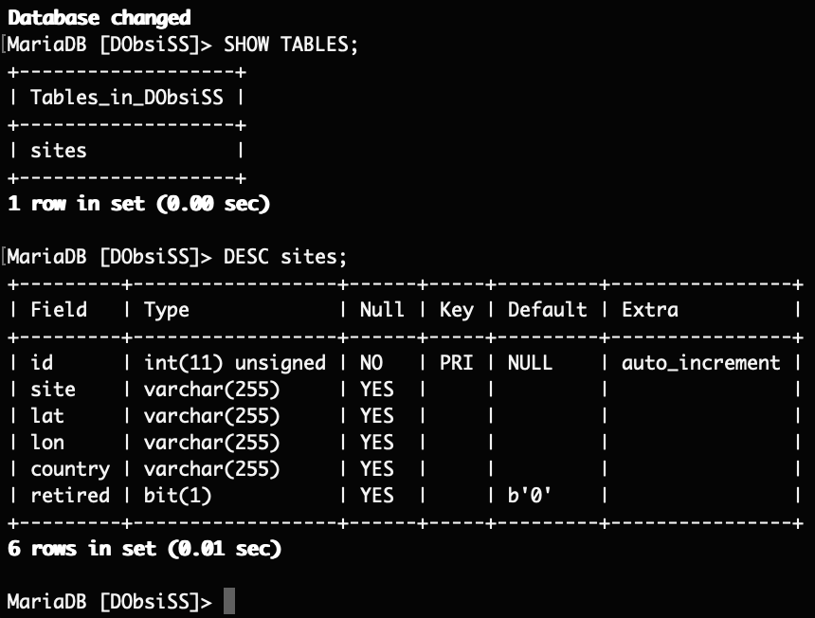
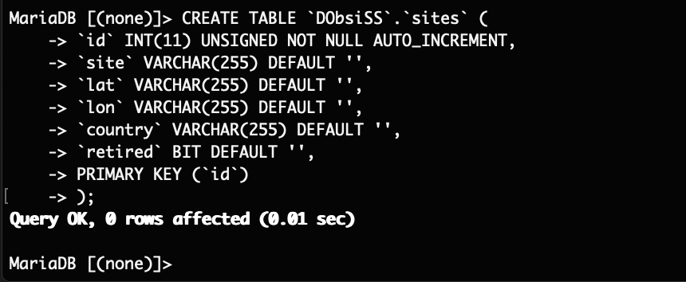
https://etherpad.wikimedia.org/p/archaeo-db-workshop
CREATING A TABLE
Syntax
Verify
Example

Slide 43
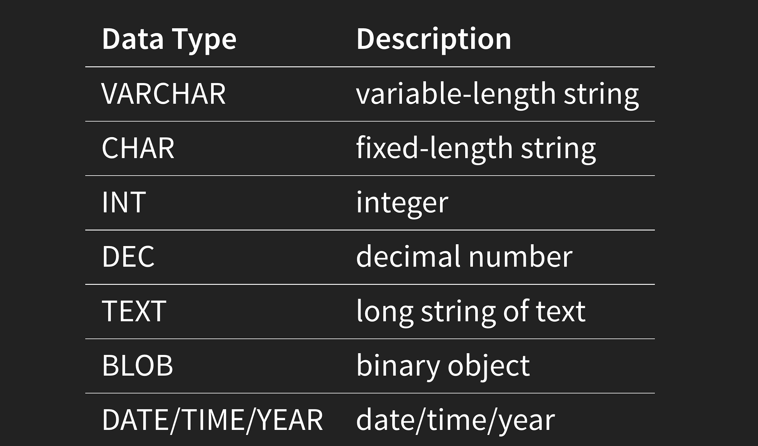
DATA TYPES

Slide 44
~ BREAK ~

Slide 45
SECTION 4
STRUCTURING OUR DATABASE

Slide 46
SCOPING TABLES
Each table represents one kind of entity
Rows represent instances of the entity
Each instance has the same kinds of attributes, but different variations thereof
Columns are assigned a data type

Slide 47
INDEXES
Indexes indicate an independent variable or set of variables, in relation to their attributes
Sometimes referred to as keys
Can be set to require that each instance be unique
Each table has a primary index, which must be unique
Pro Tip: Use sequential integers or time stamps to obtain unique values!

Slide 48
RELATIONSHIPS
Relationships indicate that the values in one index are equivalent to the values in another index
Records must relate variables of the same data type

Slide 49
SCOPING TABLES
What kinds of physical stuff are you recording?
What ‘units’ are you working with?
Who are the stakeholders? Which are the relevant domains to include?
How will data be integrated or synthesized at later stages of your project?
How are you standardizing and documenting your terminology and methods?
Who will be directly interfacing with the database?
What relevant kinds of data is not contained in the database?
How might you leave the door open for expansion?

Slide 50
SCOPING TABLES (DObsiSS)
Sites
names, coordinates
DataPoints
sites split according to blank periodization scheme
References
bibliographical references to site info, index is the reference not the site
SourcingStudies
info about each study that sourced artefacts from each site, index is the attempt
SourcingResults
results of sourcing studies
Sources
list of obsidian sources, geographic coordinates, notable features (peralkaline, snowflake, etc)
Periods
details regarding the blank periodization applied to the region

Slide 51
SCOPING TABLES (DObsiSS)
Potential expansions:
AssemblageInfo
How much is obsidian?
Artefacts
Listing of artefact-level features from each site
Possibly split into typology/technology and sourcing results
Rhyolite/Basalt/other materials
...
Sites
names, coordinates, local sequences
DataPoints
sites split according to blank periodization scheme
References
bibliographical references to site info, index is the reference not the site
SourcingStudies
info about each study that sourced artefacts from each site, index is the attempt
SourcingResults
results of sourcing studies
Sources
list of obsidian sources, geographic coordinates, notable features (peralkaline, snowflake, etc)
Periods
details regarding the blank periodization applied to the region

Slide 52
SCOPING TABLES
What kinds of physical stuff are you recording?
What ‘units’ are you working with?
Who are the stakeholders? Which are the relevant domains to include?
How will data be integrated or synthesized at later stages of your project?
How are you standardizing and documenting your terminology and methods?
Who will be directly interfacing with the database?
What relevant kinds of data is not contained in the database?
How might you leave the door open for expansion?

Slide 53
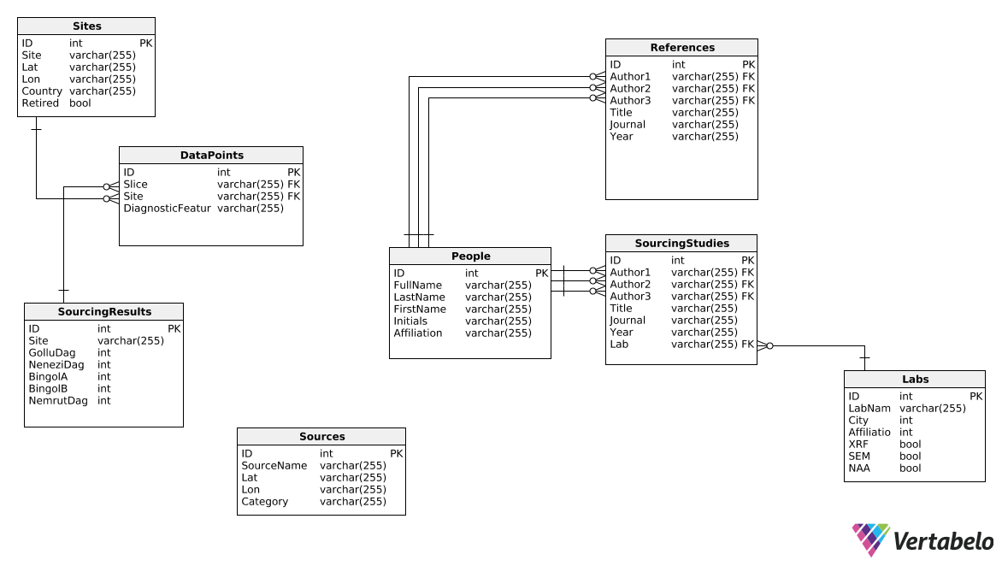

Slide 54
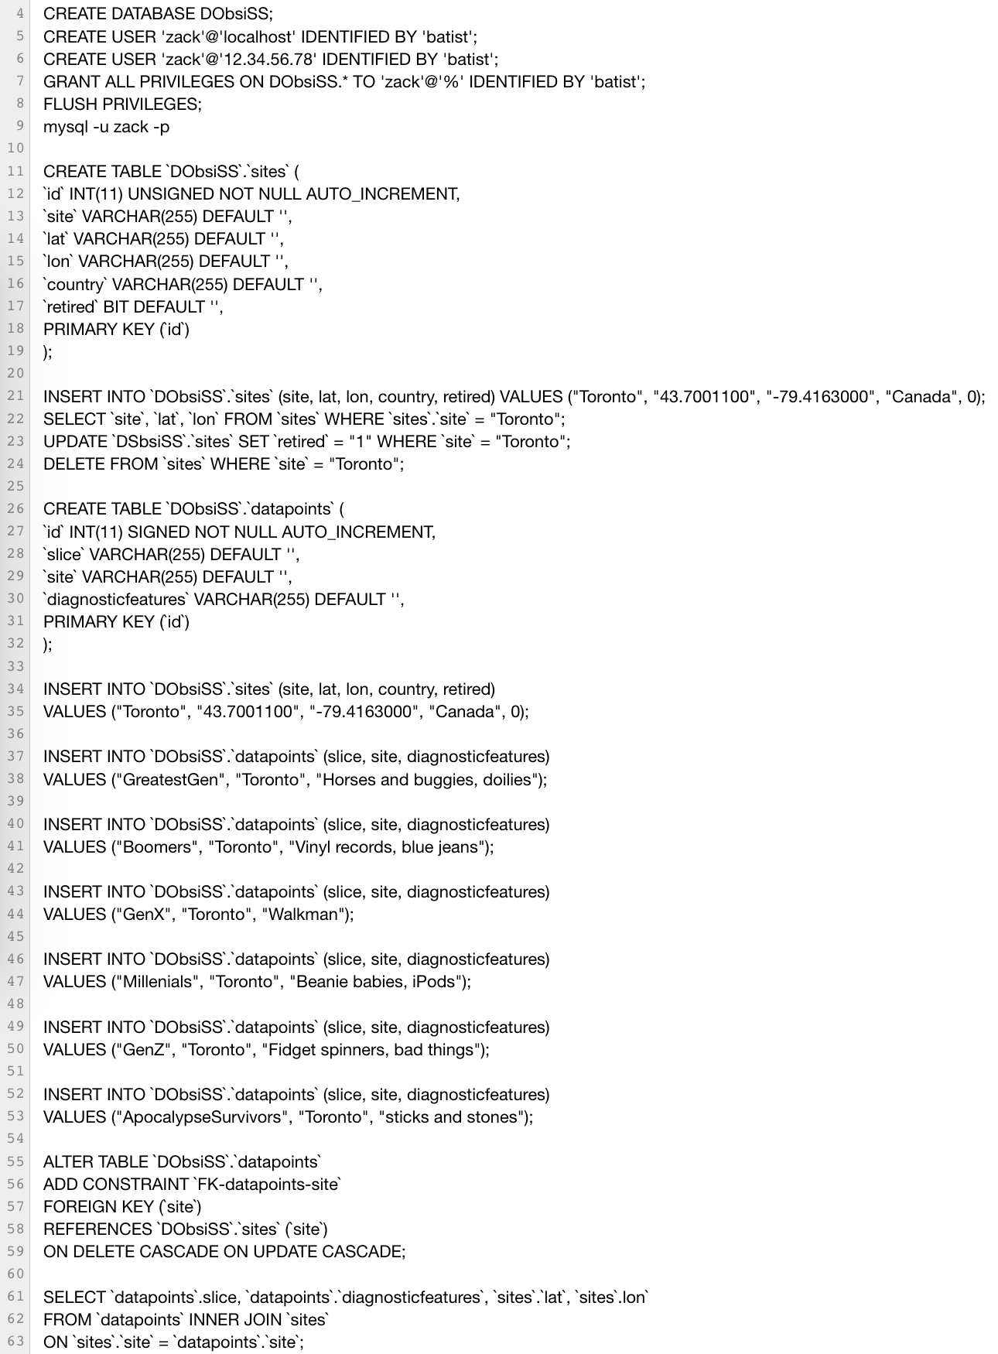
CREATE database, GRANT USER privileges
CREATE TABLE called ‘sites’
INSERT values for site named Toronto
Demonstrate the SELECT, UPDATE and DELETE queries
CREATE a second table called ‘datapoints’
INSERT values into datapoints
Create relationship between `sites` and `datapoints` via their mutual field, `site`
JOIN query

Slide 55
SECTION 5
MANIPULATING DATA

Slide 56
QUERIES
Everything you do is expressed as a self-contained logical statement
There are a few fundamental commands:
INSERT
UPDATE
SELECT
DELETE
JOIN

Slide 57
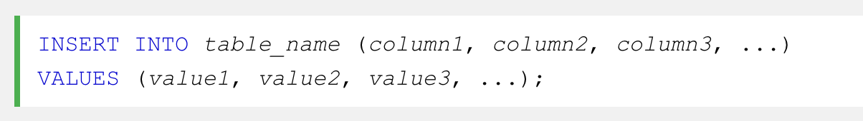
INSERT - Inserts records into a table

Slide 58

UPDATE - Modified cells within a table, when they match certain conditions
SiteName = “Abu Hureyra”
Country = “Syria”
...

Slide 59
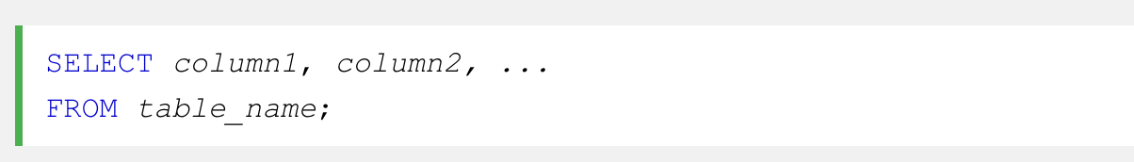

SELECT - Retrieves data from a table

Slide 60
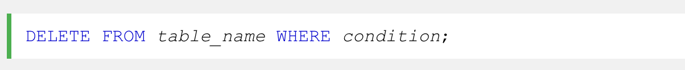
DELETE - Deletes a record
SiteName = “Abu Hureyra”
Country = “Syria”
...

Slide 61
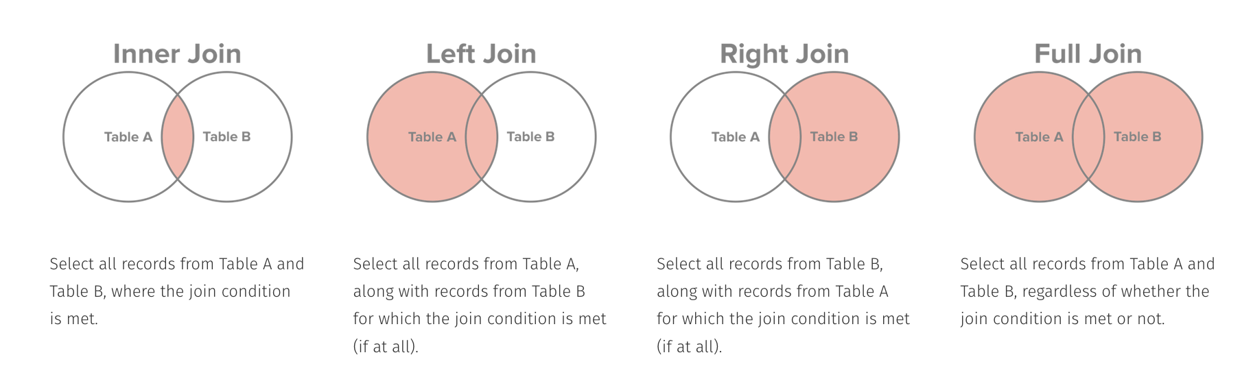
JOIN - Used as optional component of SELECT queries when you want to integrate data spanning multiple tables

Slide 62
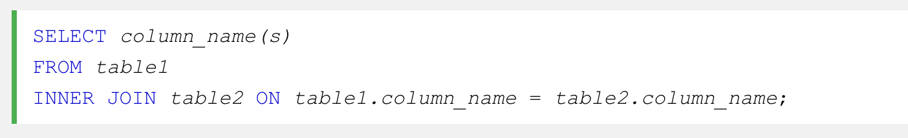
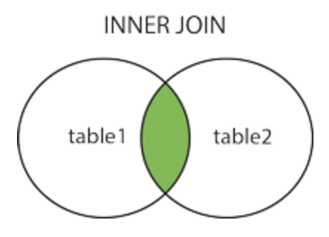
INNER JOIN - Only retrieves records from both tables that have a certain value in common

Slide 63
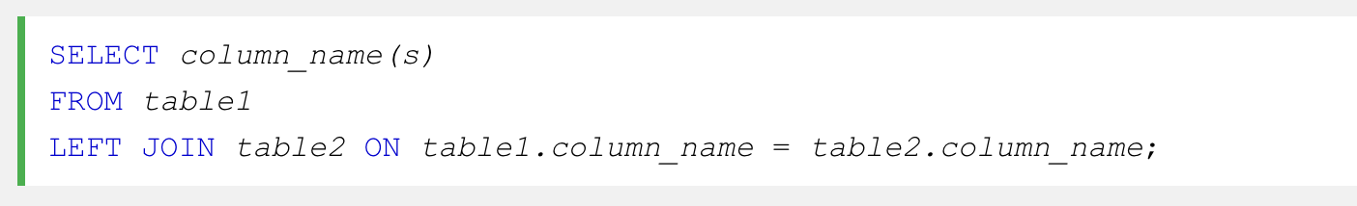
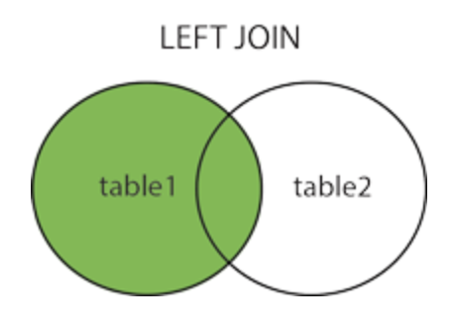
LEFT JOIN - Retrieves all records from one table and only records from another table when there is a corresponding record in the first table

Slide 64
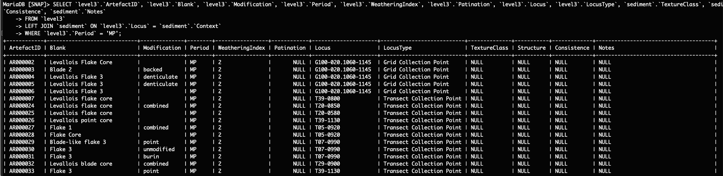
“Computer -- show me some characteristics of lithics from the Middle Palaeolithic alongside some geoarchaeological characteristics of their contexts”
** beep boop beep beep boop beep **

Slide 65
SECTION 6
FRONT-END DEVELOPMENT

Slide 66
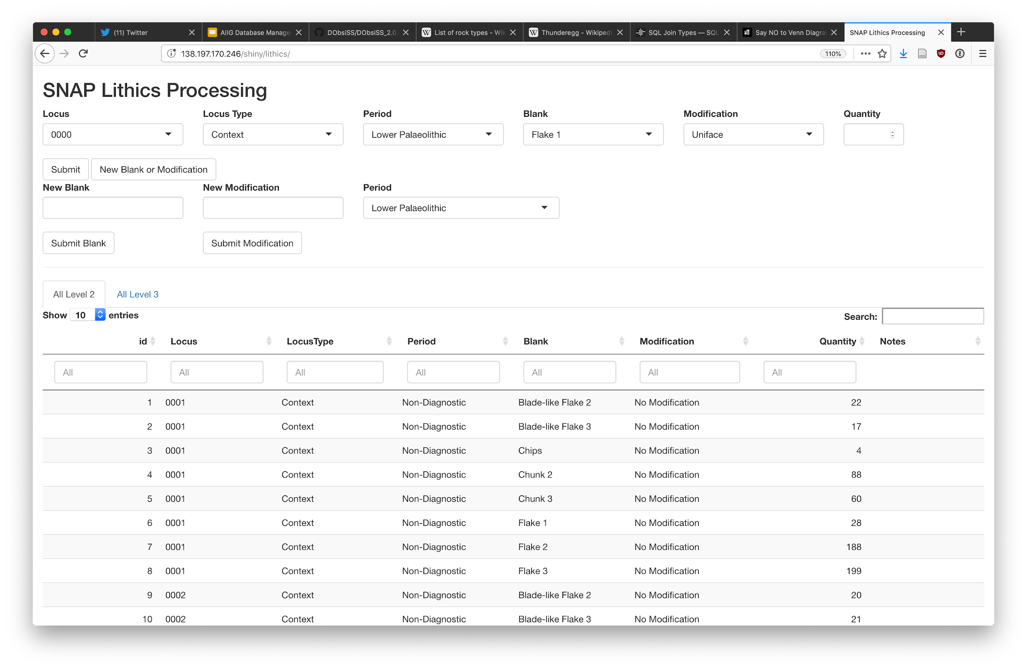
FLIRT - Flexible LIthic Recording Tool

Slide 67
FLIRT - Flexible LIthic Recording Tool (R Shiny, JavaScript)
Retrieves list of loci that match the specified LocusType (excavation context, transect collection point, aeolianite deposits, etc) in the `AllLoci` table
This info get passed into an INSERT query when submit button is clicked
Submit button also ‘splits’ each record into a number of records specified in the Quantity field, and INSERTs those into the `level3` table, which is artefact-level analysis
Submit button searches the respective table for existing records to avoid duplicates, and if it finds none then passes this info to an INSERT query and refreshes the Blank/Modification dropdowns to include the update
Each cell can be edited, which runs an UPDATE and subsequent SELECT query to make changes and refresh the data

Slide 68
Junk

Slide 69
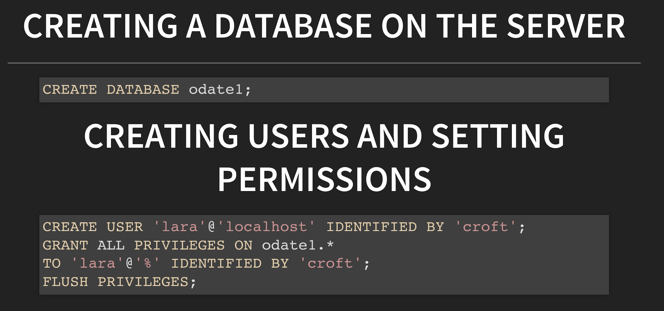

Slide 70
Let’s go!
ssh workshop@xxx.xxx.xxx.xxx
Input password: xxxxxxxx
Accept security certificate, type ‘yes’
You’re in! 🎉
sudo mysql
CREATE DATABASE ‘<database>’;
CREATE USER ‘<username>’@‘localhost’ IDENTIFIED BY ‘<password>’;
GRANT ALL PRIVILEGES ON ‘<database>’.* TO ‘<username>’@‘%’ IDENTIFIED BY ‘<password>’;
FLUSH PRIVILEGES;
exit
Mysql -u <username> -p
Enter your password
🥳

Slide 71
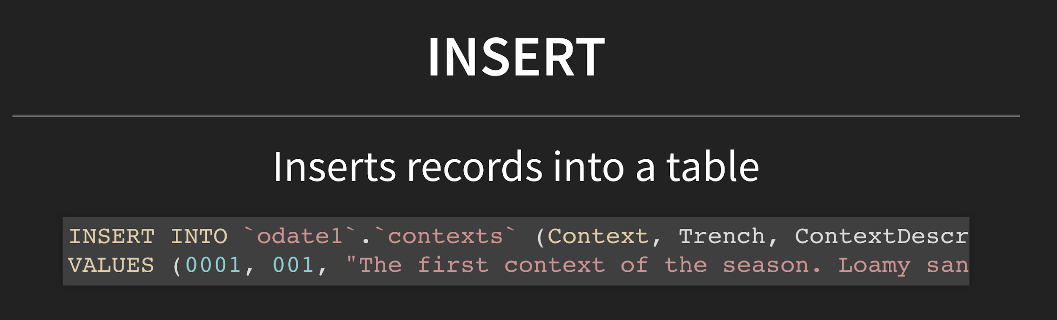

Slide 72
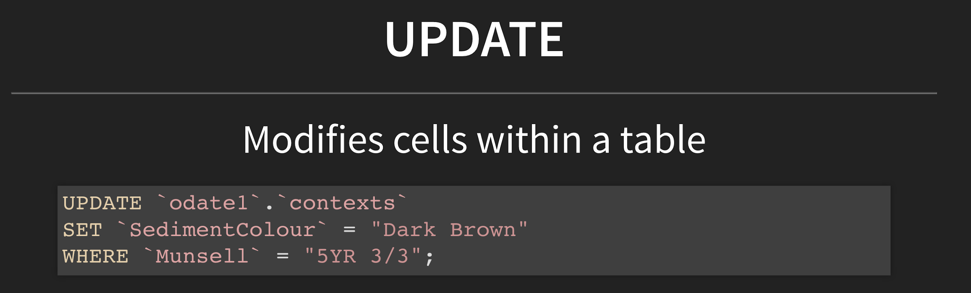

Slide 73
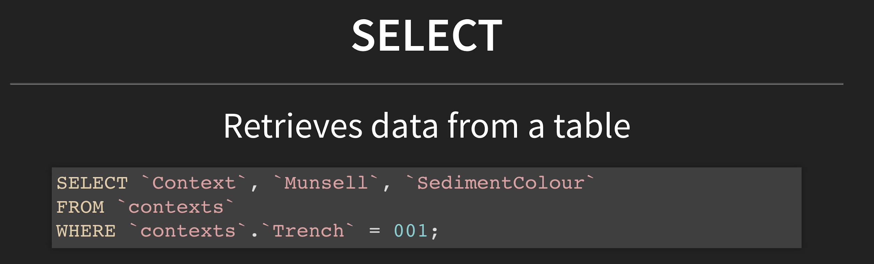

Slide 74
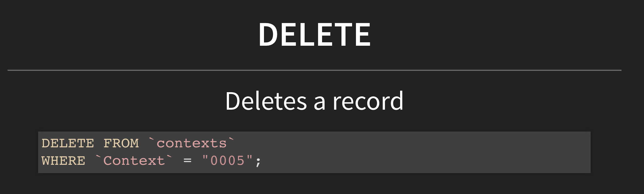

Slide 75
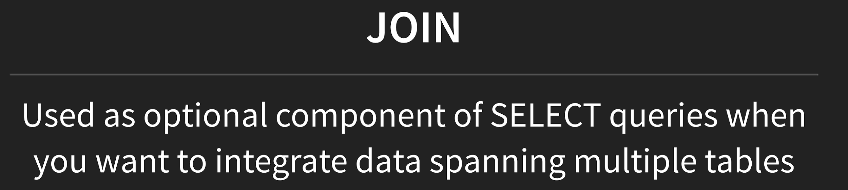

Slide 76
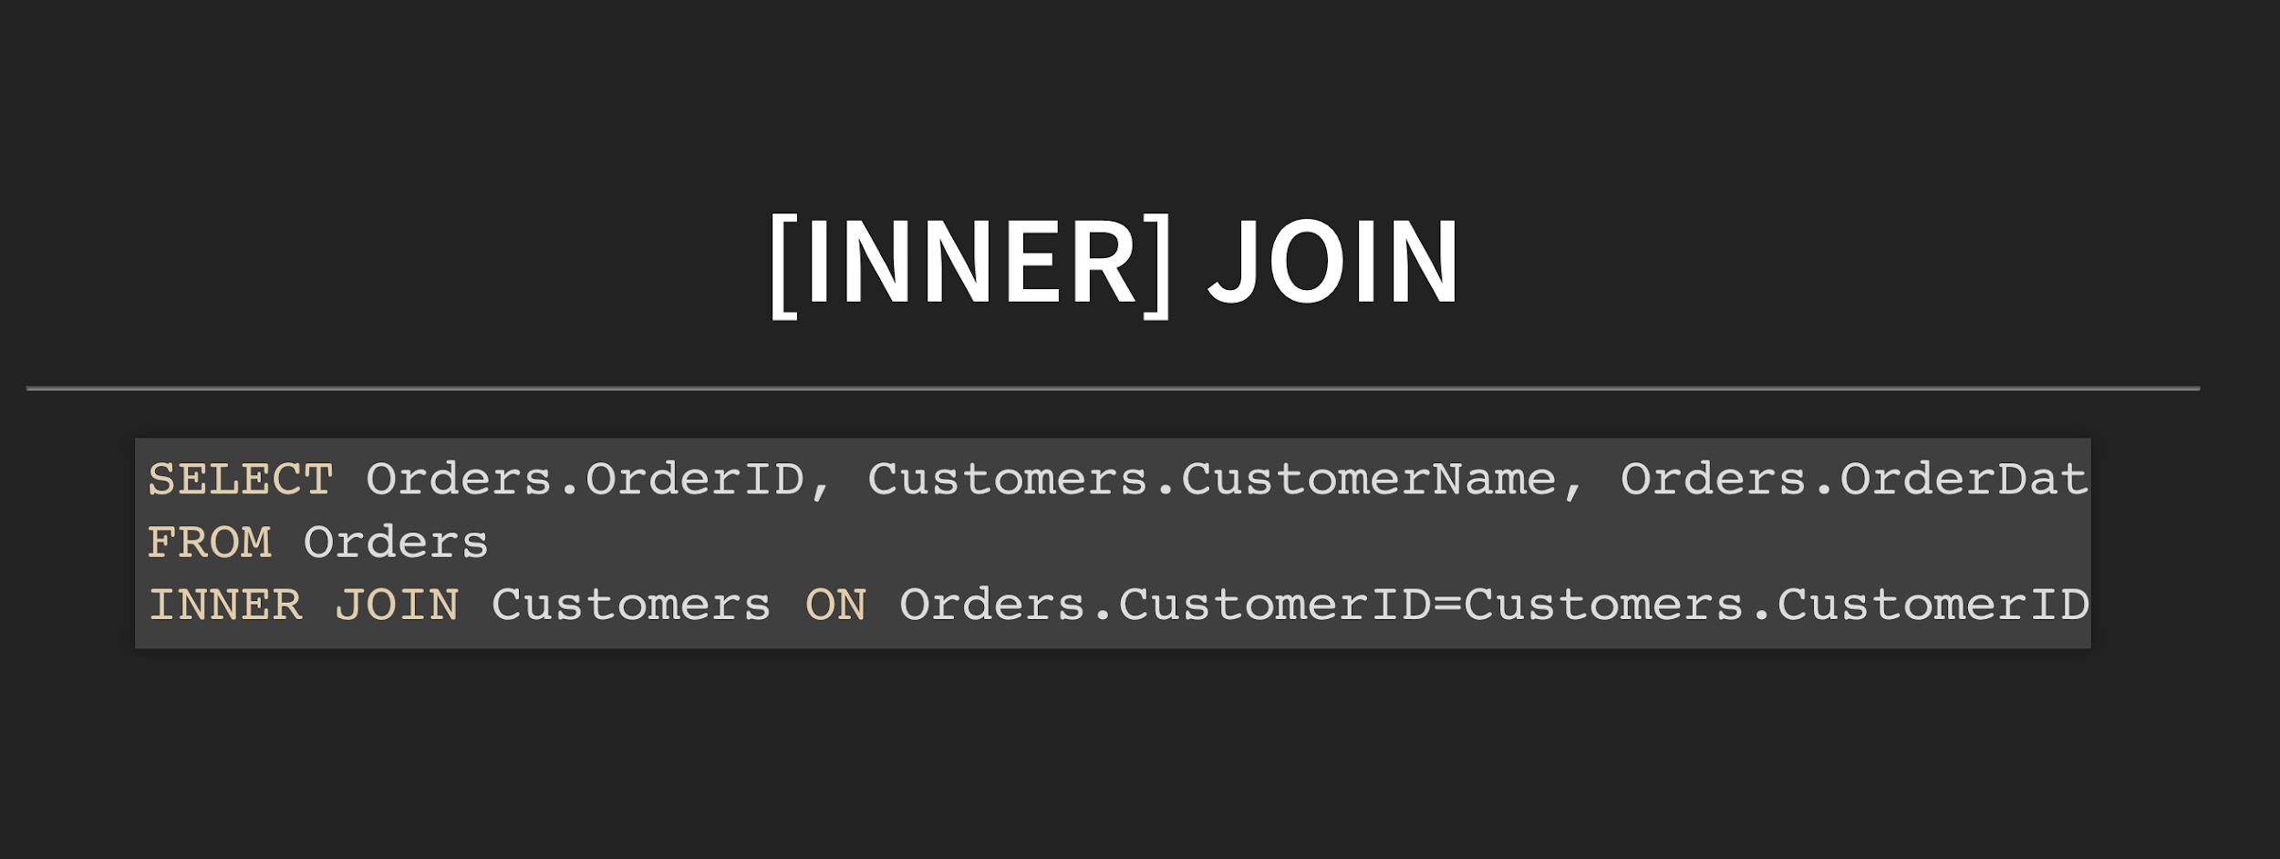

Slide 77
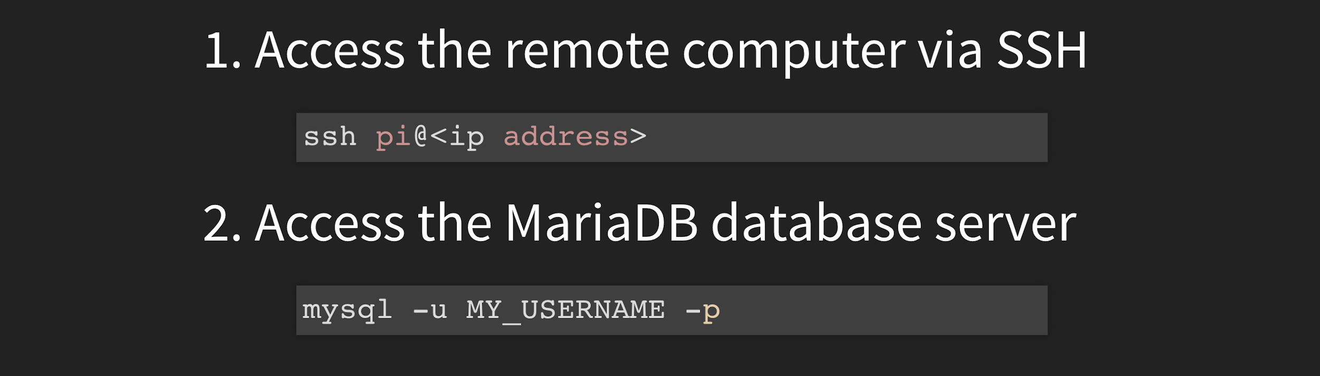
ACCESSING OUR DATABASE SERVER

